Slide 1
Data Identification for Analyzing the Relative Positions of Smaller Players in Sports Betting and Online Casino Industry
Aaron Zhao

Slide 2
Content
Abstract
Data Identification
Brief Analysis
Integration with Computer Science
Reference

Slide 3
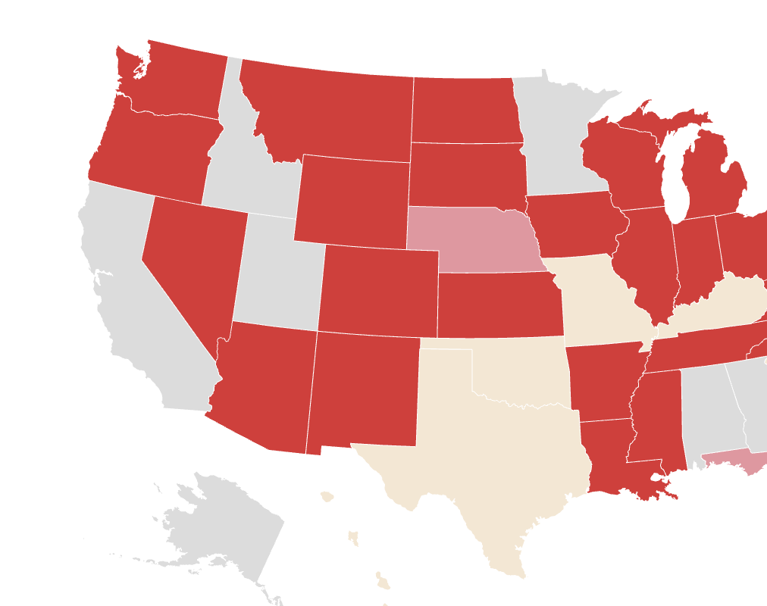
CASE 1 | ABSTRACT
Sports Betting and Online Casino takes around 33.3% of online gambling in 2022 and will be experiencing a compound annual growth rate (CAGR) of approximately 12% during the forecast period 2022 to 2030 [2] as the sports industry keeps growing [3] [4] and the online gambling industry in the U.S. becomes more mature and more profitable [5] [6] [7].
This case study aims to identify data as prerequisites to conduct future analysis on the relative positions of smaller players in Sports Betting and Online Casino Industry. This case study mainly focuses on identifying and extracting necessary data while analyzing smaller players' relative positions. To provide a more structured and detailed analysis, data were categorized into three buckets: Company, Market/Industry, and Customer.
Data gathered from different sources were usually messy, so they were cleaned, processed, and transformed into a structured dataset. Then, a machine learning model (for the sake of time, DL can be firstly applied) was designed and trained to predict the future relative positions of companies. A brief analysis was conducted based on the data gathered by extracting websites and open-source databases, and the Market Position Index and Relative Position Index showing the relationship among smaller players in Sports Betting and Online Casino were proposed.

Slide 4
CASE 1 | DATA IDENTIFICATION
Companywise data reflect the current situation and the profitability of the company itself. They can normally be found in the annual report or other public records published by the company. Also, many indexes can show the company’s current situation on a scale of percentage and work as indicators of the company’s overall financial health. So, I categorized companywise data into direct data (revenue, assets, liability, costs, etc.) and indirect data (net profit margin, D/E ratio, operating margin).
Data Source: Annual Report, online website, yahoo finance, google finance)/annual reports

Slide 5
CASE 1 | DATA IDENTIFICATION
Industry Data were categorized into 3, which are data related to the company itself and the data of the competitors and the data of the market. One key metric for analyzing a company's market position is market share. Market share is simply calculated by taking the company's sales over a given period and dividing it by the total sales of the industry over the same period. This metric gives a clear picture of how much of the total market the company is capturing and can be used to compare the company's performance to that of its competitors. TAM, SAM, SOM are also data from the company’s perspective. Distribution data, product and pricing data should be taken into consideration since they can also be used to calculate and compare the company’s current situation with its competitors and reflect the market position of it.
Data Source: Online website, online reports

Slide 6
CASE 1 | DATA IDENTIFICATION
Customer data is information about a company's customers, such as demographics, purchasing habits, and feedback. It is crucial for companies to understand their customers as it helps them to make informed decisions and tailor their products and services to meet customer needs and preferences.
Data Source: Third-party website(fetched thru API), similarweb, CrunchBase

Slide 7
CASE 1 | BRIEF ANALYSIS
Financial performance
Customer experience
Market Position
Innovation and Regulatory compliance
Since as an individual, I was not able to get fully access to data websites such as SimilarWeb, Crunchbase, Data40.com, etc, so I only chose some critical parameters to do a brief analysis on the market position. Comprehensive analysis should be based on multiple datasets.

Slide 8
CASE 1 | BRIEF ANALYSIS (Market Share & Revenue)
A strong market position of FanDuel, owned by Flutter Entertainment can be observed by this pie chart. The brand is estimated to hold 46.6% of the Gross Gaming Revenue (GGR) in states where online sports betting is available. DraftKings comes in second with 20.2% of the GGR, while BetMGM and Caesars hold 14.1% and 7.5% respectively.
Additionally, BetRivers, Barstool Sportsbook, and PointsBet also contribute with 2.9%, 2.8% and 2.6% of the GGR, respectively. Out of the 60 operational online sports betting operators, only seven brands have a market share greater than 1%, with the remaining 53 firms competing for the remaining market share.
These seven brands account for a combined 96.7% of the GGR, leaving just 3% for the other 53 companies.

Slide 9
CASE 1 | BRIEF ANALYSIS (Market Share & Revenue)
A strong market position of FanDuel, owned by Flutter Entertainment can be observed by this pie chart. The brand is estimated to hold 46.6% of the Gross Gaming Revenue (GGR) in states where online sports betting is available. DraftKings comes in second with 20.2% of the GGR, while BetMGM and Caesars hold 14.1% and 7.5% respectively.
Additionally, BetRivers, Barstool Sportsbook, and PointsBet also contribute with 2.9%, 2.8% and 2.6% of the GGR, respectively. Out of the 60 operational online sports betting operators, only seven brands have a market share greater than 1%, with the remaining 53 firms competing for the remaining market share.
These seven brands account for a combined 96.7% of the GGR, leaving just 3% for the other 53 companies.

Slide 10
CASE 1 | BRIEF ANALYSIS (Growth since 2018)
In terms of growth, the sports betting industry has been growing rapidly in recent years. FanDuel's revenue has increased by 300% since 2018, while DraftKings' revenue has increased by 98% over the same period.
In 2020, betMGM reported a 100% year-over-year increase in online sports betting revenue and a 400% increase in mobile sports betting handle. However, by comparing revenue of 2021 with 2019, it slightly decreased from 11.763 to 9.68 b.
Caesars experienced a 1200% growth since 2019 from 26 m to 337 m. PointsBet grew from 0.7 m to 40.9 m.

Slide 11
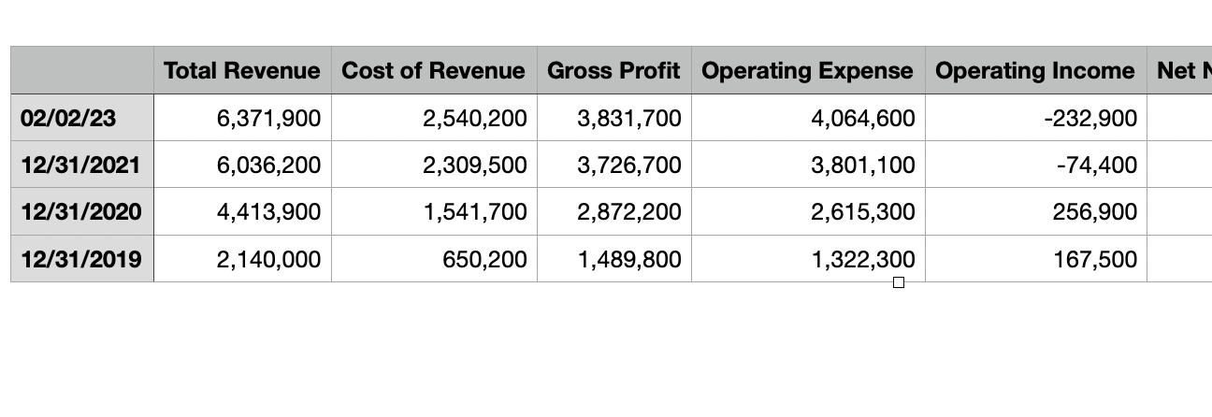
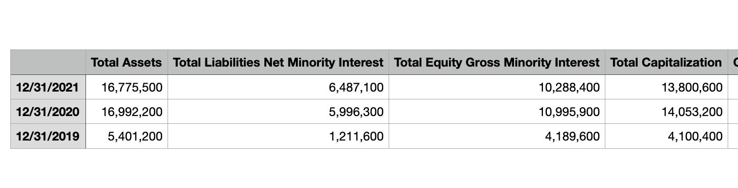
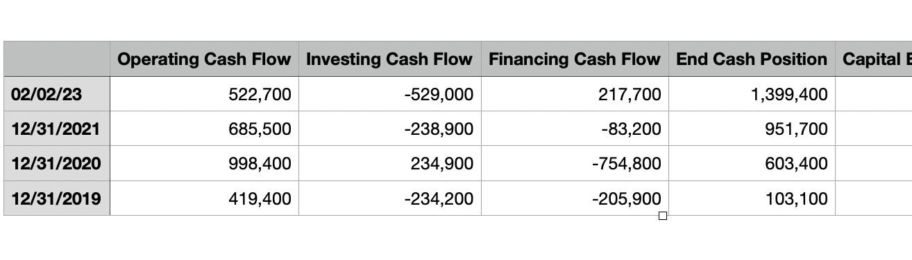
CASE 1 | BRIEF ANALYSIS (More Data)
Income Statement of Flutter Entertainment
Balance sheet of Flutter Entertainment
Cash Flow of Flutter Entertainment
I also scraped further data and conducted prioritization for further cross validation with other companies, can be found in folder data_scrape/pseudo_data

Slide 12
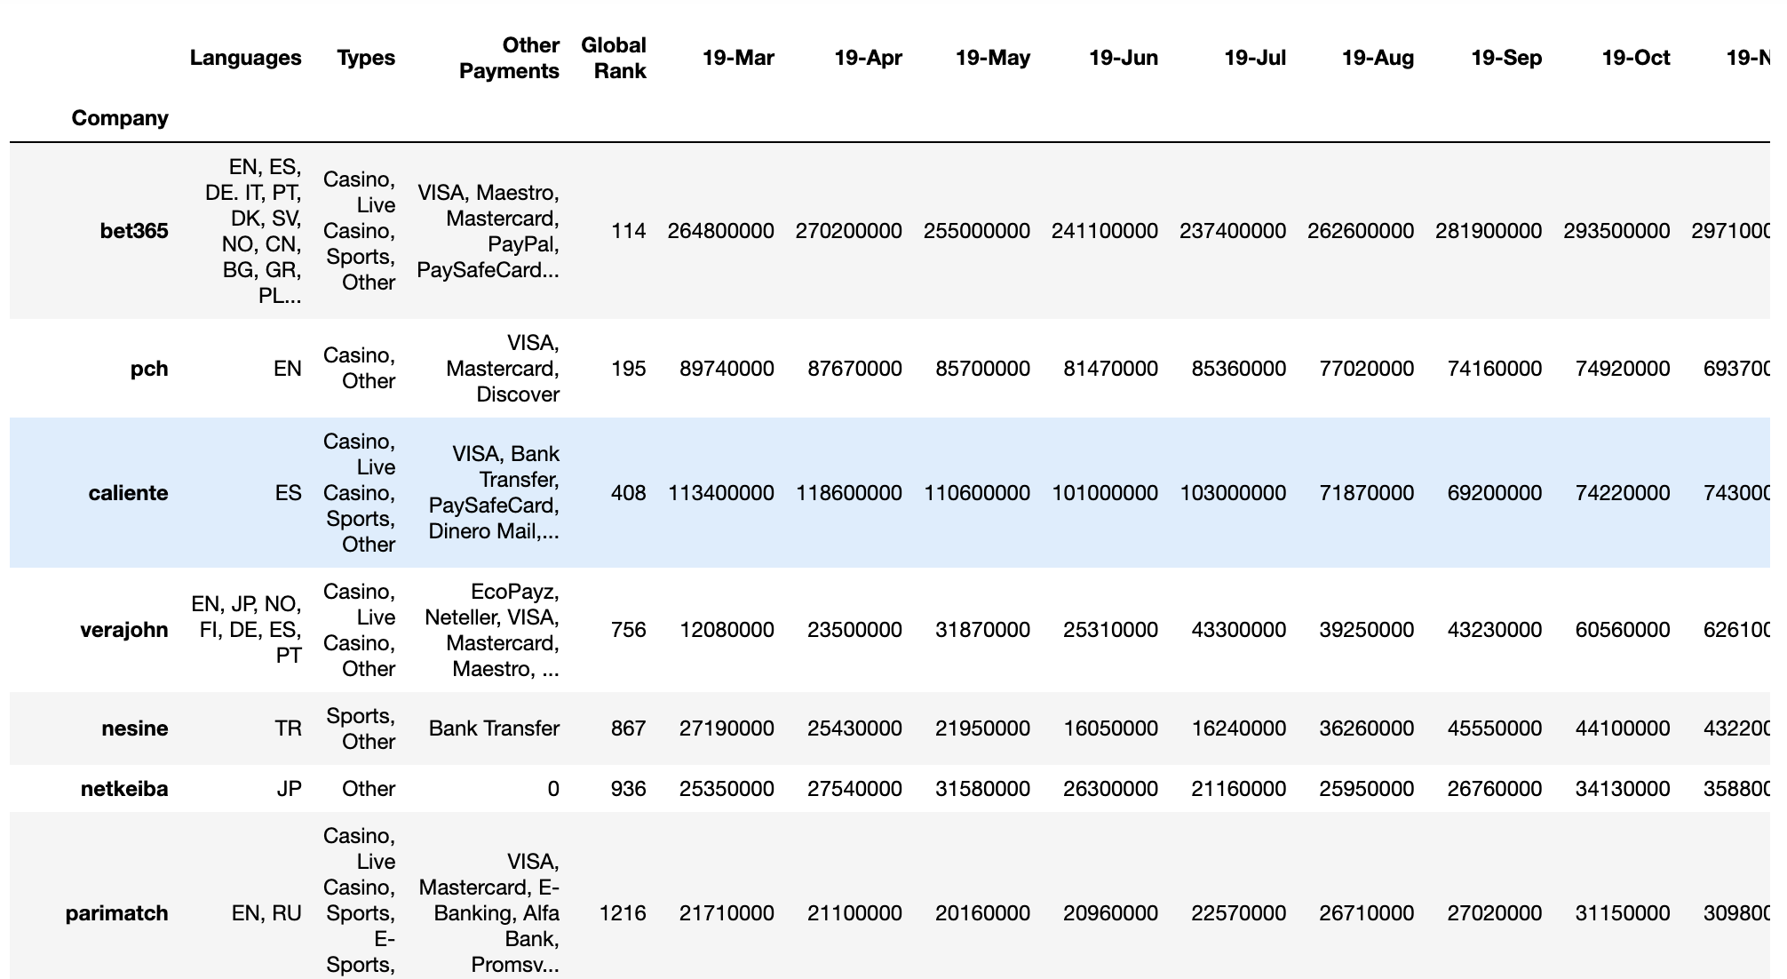
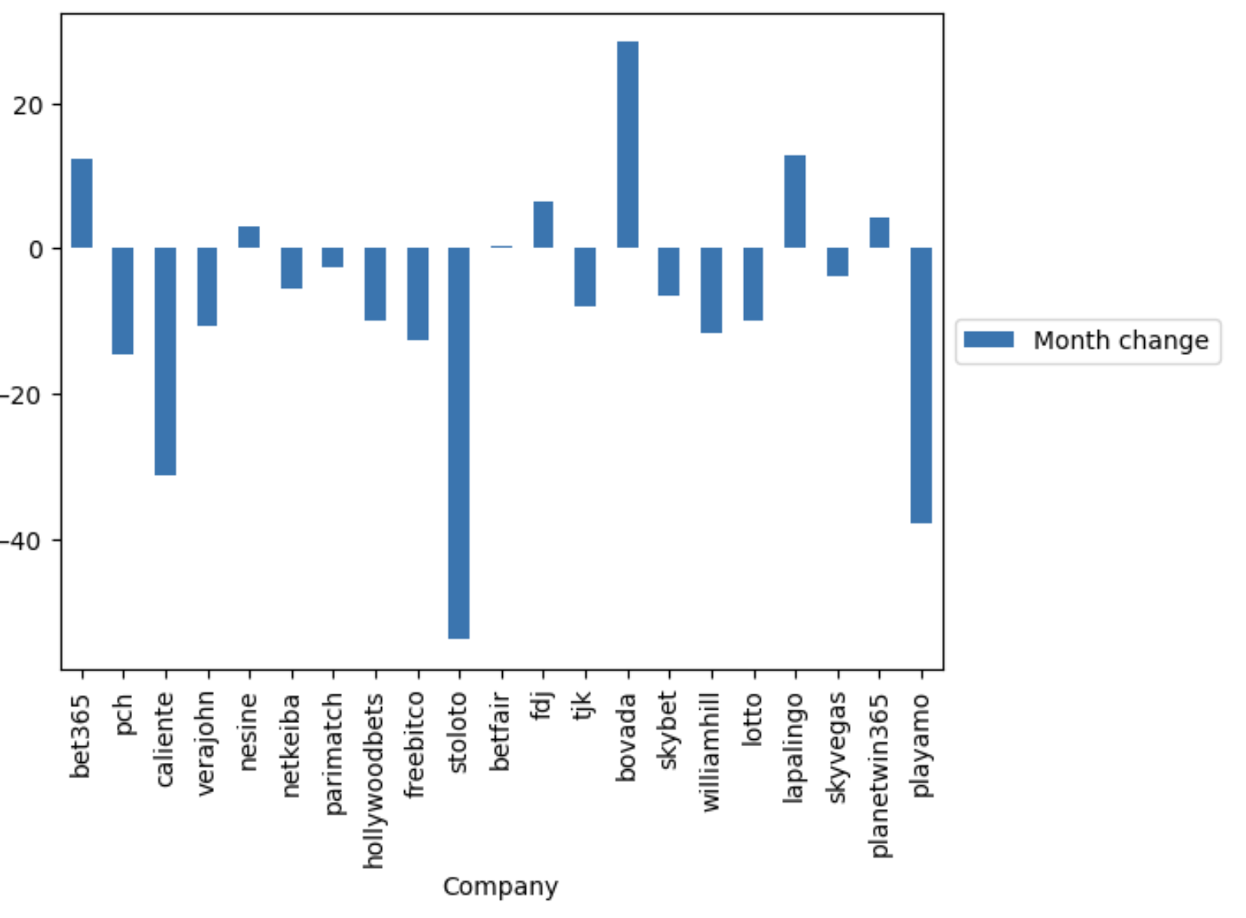
CASE 1 | BRIEF ANALYSIS (Customers)
Website visits can indicate a level of interest in a company, it is one factor among many that can impact a company's market position. Additionally, monthly changes, is useful for tracking long-term performance, is a great help while analyzing the comprehensive picture of a company's overall market position apart from companies’ financial performance
I only have limited access to the data of these sports betting website, however, web scraping is def a method if time permits

Slide 13
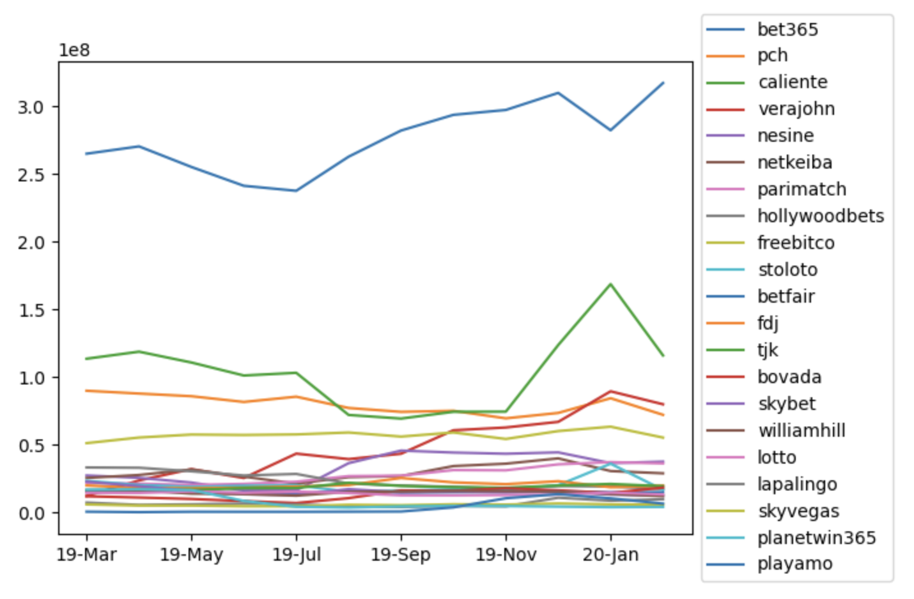
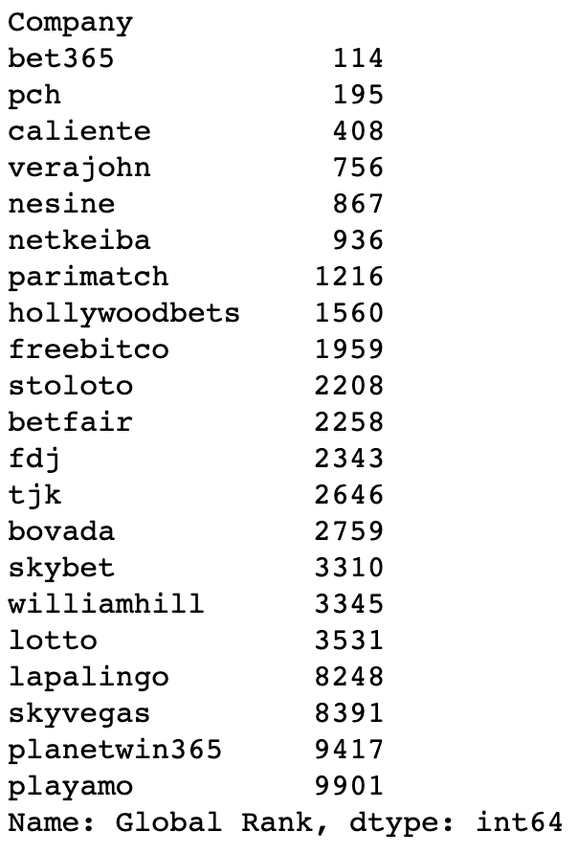
CASE 1 | BRIEF ANALYSIS (Customers)
The corelation between Global Rank and Mean of website visit is -0.46111983519583766

Slide 14
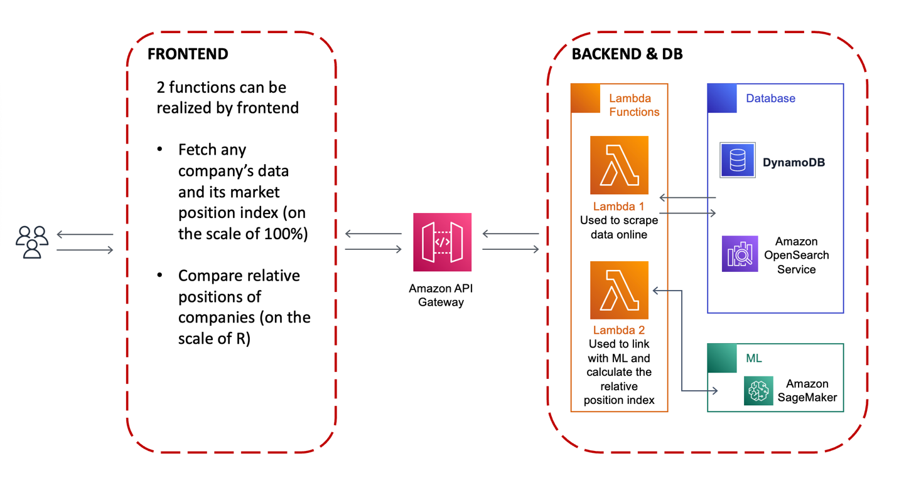
CASE 1 | INTEGRATION WITH COMPUTER SCIENCE
System Design
This APP was specifically designed for relative positions analysis and the system design is shown above. The whole APP consists of 2 main parts as any other app, which are frontend and backend. For the sake of simplicity, I purposely put DB inside the scope of Backend.

Slide 15
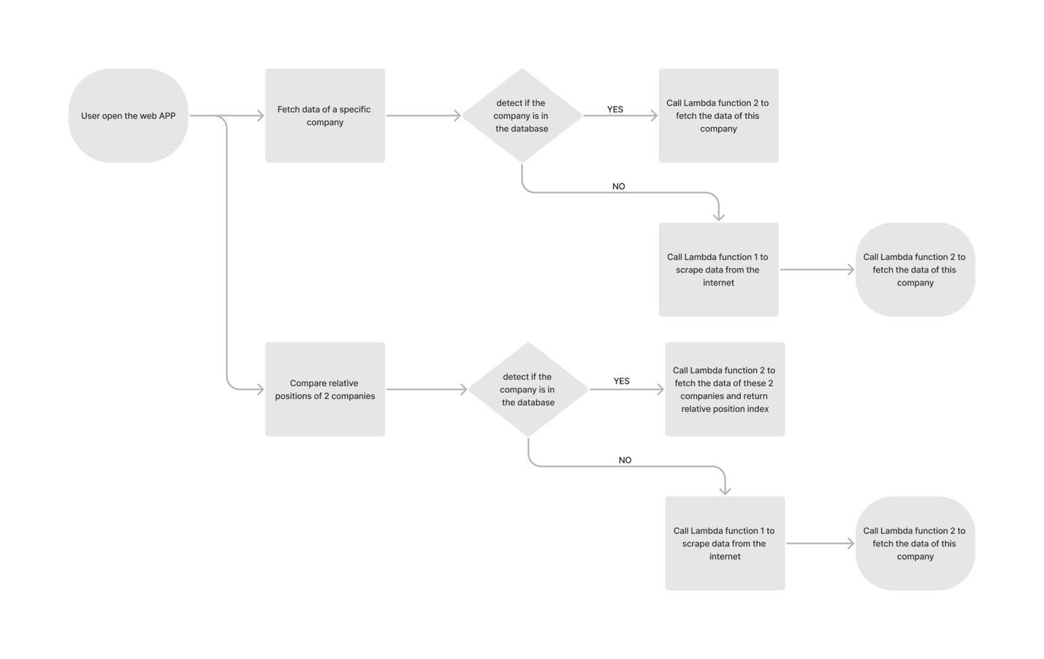
CASE 1 | INTEGRATION WITH COMPUTER SCIENCE
Functionally and User Story
Fetch data
User opens the APP
User types out the name of the company
If this company’s data are in the DB, then Lambda function 1 will be invoked to fetch the data
If the data are not in the DB, Lambda function 2 will be firstly invoked to scrape data from the internet and then Lambda function 1 will be invoked to return the data
Compare relative position
User opens the APP
User types out the names of 2 companies
If the companies’ data are in the DB, then Lambda function 1 will be invoked to fetch the data
If the data are not in the DB, Lambda function 2 will be firstly invoked to scrape data from the internet and then Lambda function 1 will be invoked to return the data

Slide 16
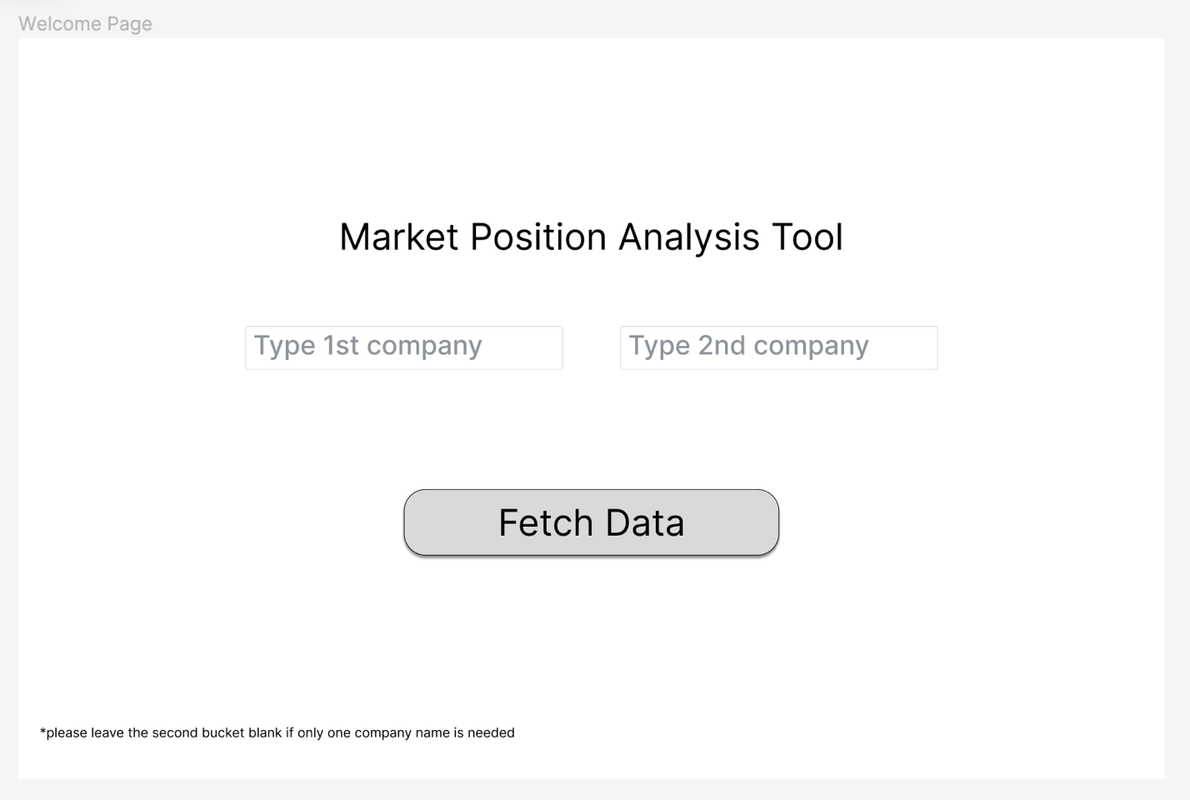
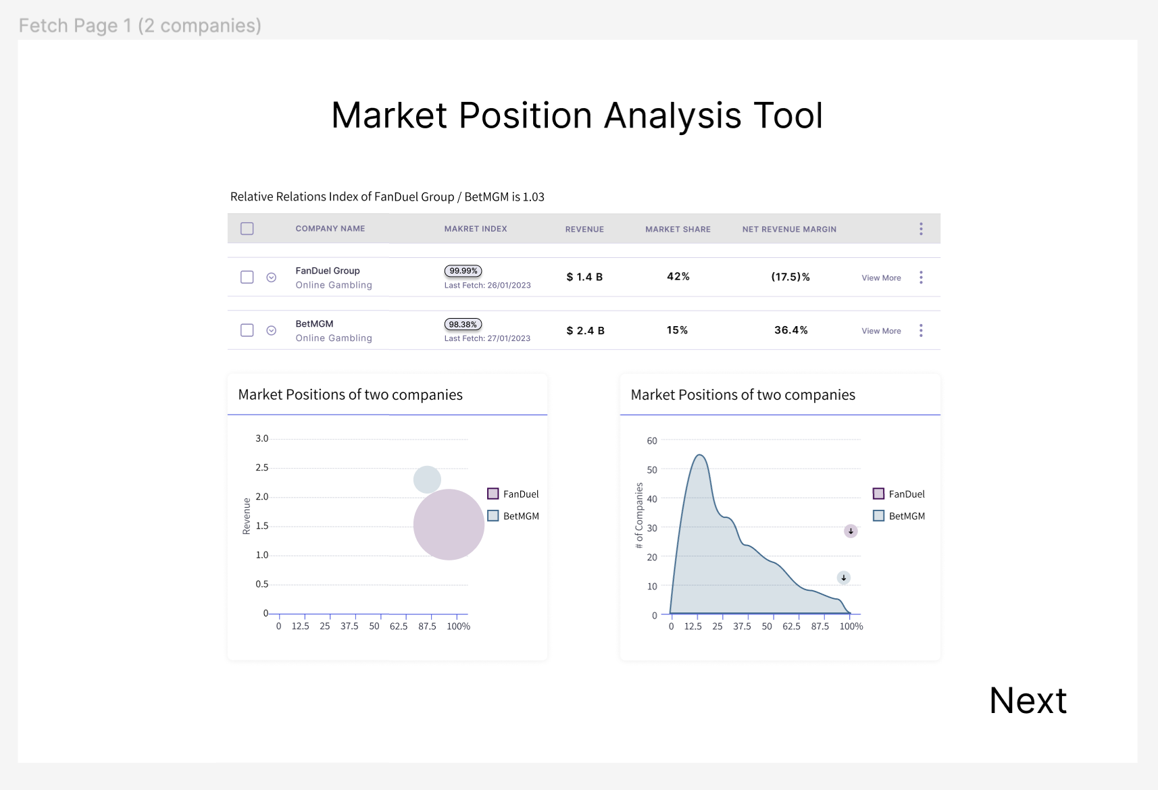
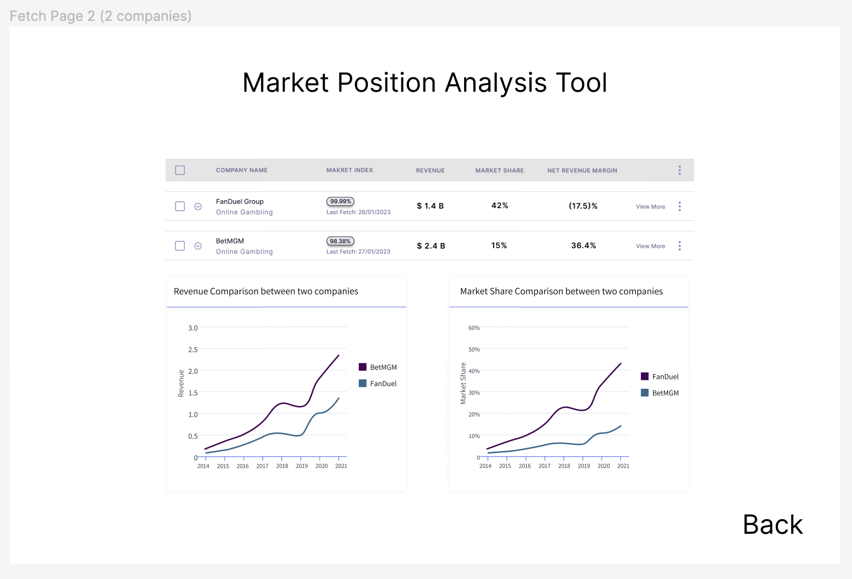
CASE 1 | INTEGRATION WITH COMPUTER SCIENCE
Frontend
Relative Relations Index of FanDuel and BetMGM is 1.03(pesudo)
https://www.figma.com/file/jCIDlr5oOGNzcK9sySX6xA/Untitled?node-id=0%3A1&t=CaoJMdQ8rfiQlBGi-1

Slide 17
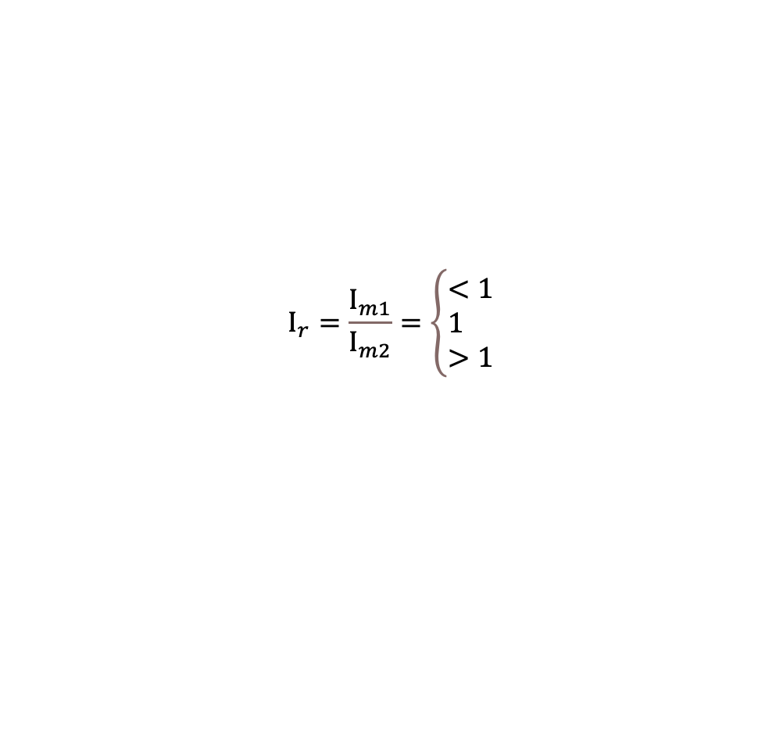
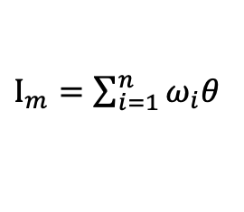
CASE 1 | INTEGRATION WITH COMPUTER SCIENCE
Algorithm
For any company, its relative market position to another company and its own market position can be expressed in a more quantitative way. In order to do that, I proposed an algorithm using ML/DL to generate the potential market position described by an index which is call Market Position Index, it is calculated based on the all the data that are feed into the DL model.
$Ι_{m}=\sum_{i=1}^{n}{ω_{i}θ}$
Each industry will have its own set of weights (ѡ) in order to generate the I_{m}. The index will also be cross validated by the ranking of companies’ revenue, maybe KNN will be adapted and SVM will be used to train the right set of w
After the set of weights is generated, a more quantitative market position will be simply got as an extra supplement/resource.
$$Ι_{r}=\frac{Ι_{m1}}{Ι_{m2}}=\left\{\begin{aligned}&<1 \\ &1 \\ &>1\end{aligned}\right.$$
When $Ι_{r}$ is larger than 1, which means the Market Position Index of the denominator is larger than the Market Position Index of the numerator. This means the denominator has a relative stronger competitive market position than the numerator. The larger the $Ι_{r}$, the stronger the competitiveness the denominator has compared to the numerator, vise versa.

Slide 18
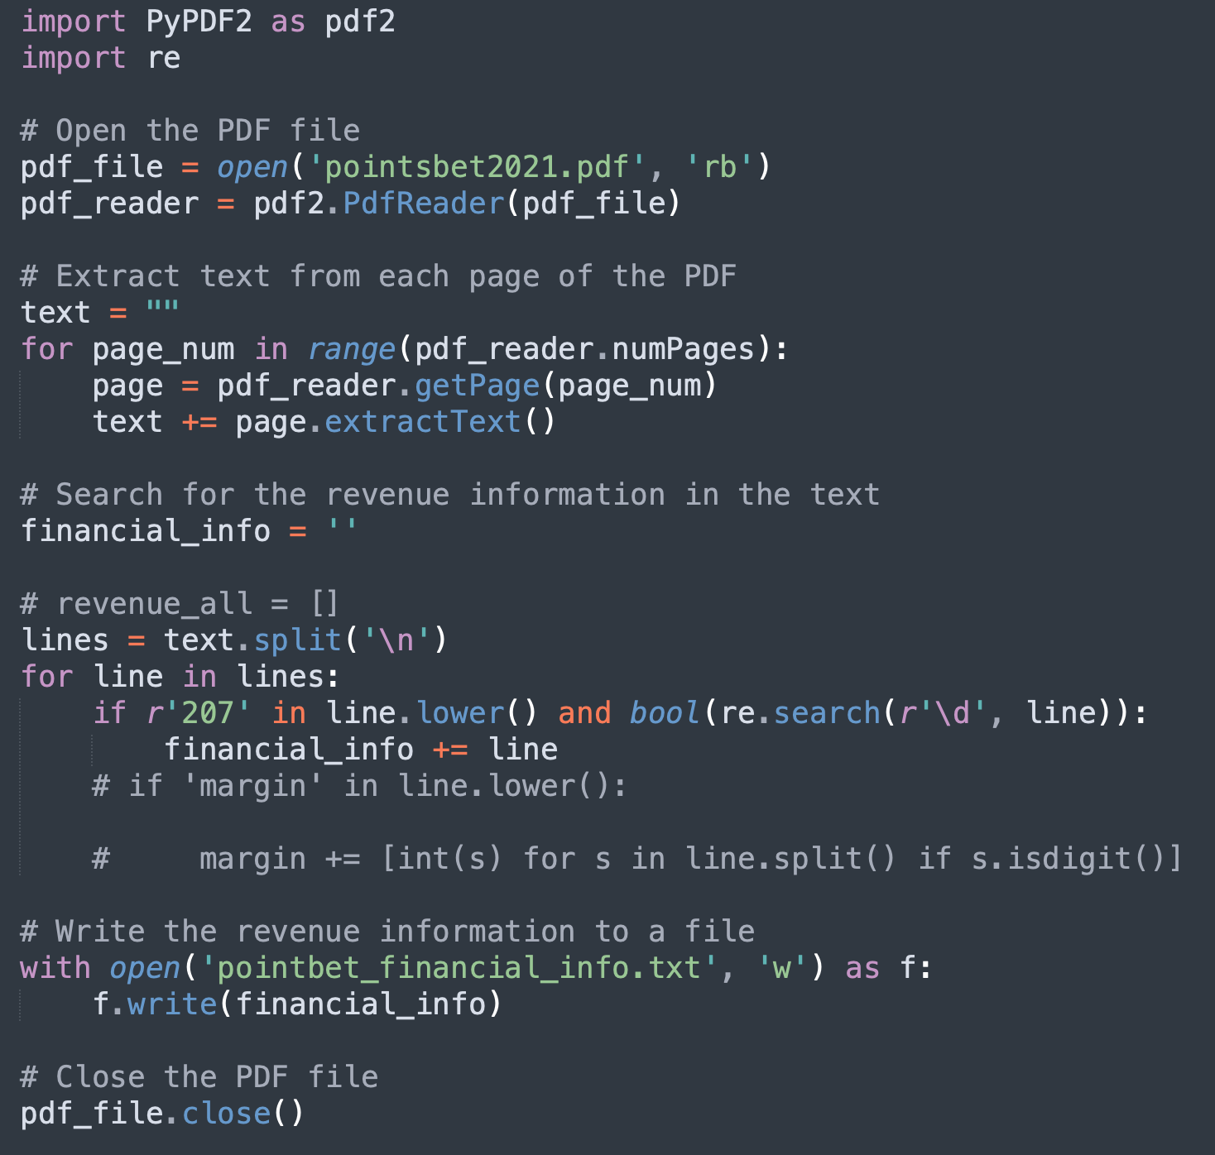
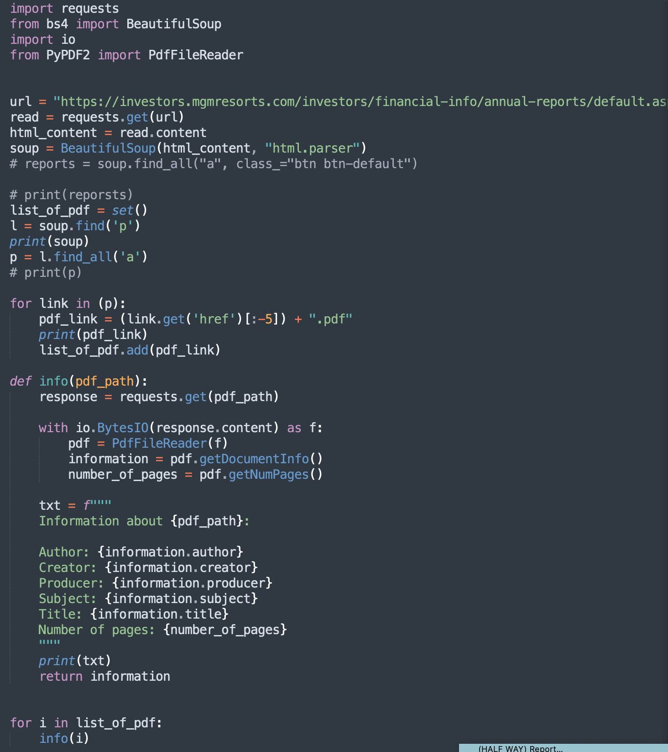
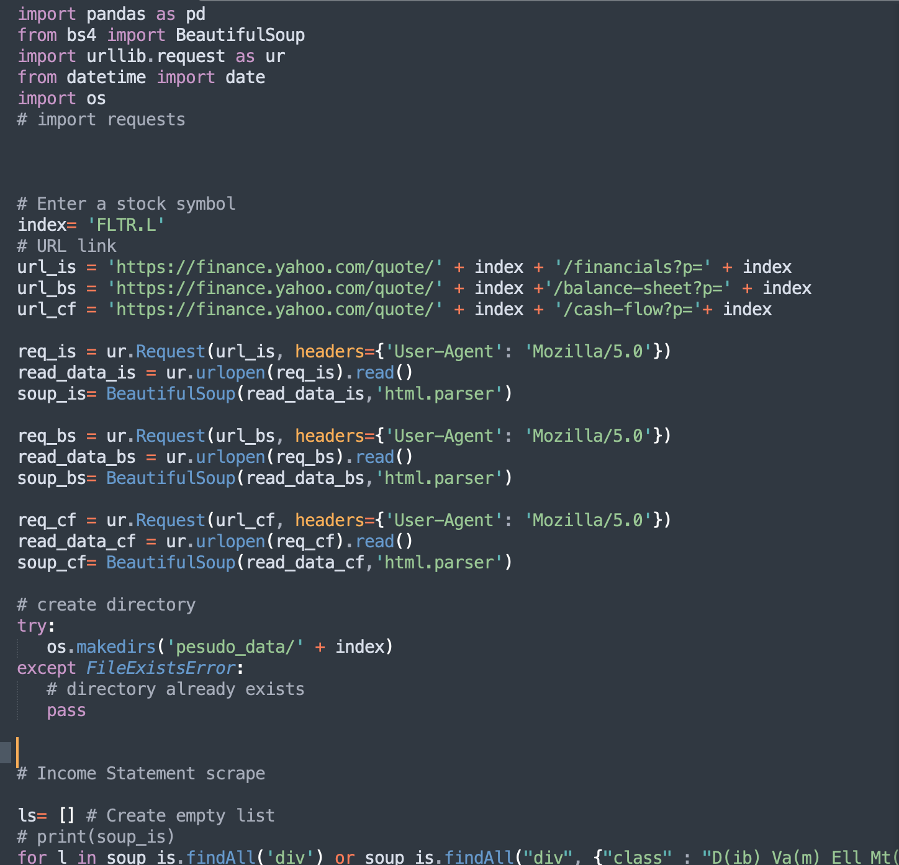
CASE 1 | INTEGRATION WITH COMPUTER SCIENCE
Supporting Codes:
Scraping keyword from PDF
Scraping PDF from website
Scraping Data from financial website(yahoo finance, etc)\
…
Please check the folder for more codes I wrote

Slide 19
CASE 1 | REFERENCE
[1] J. J., "Global Online Gambling Market & Betting Market Size Worth $ 145.6 Billion by 2030 at a 12% CAGR: Custom Market Insights.," www.globenewswire.com, 12 09 2022. [Online]. Available: https://www.globenewswire.com/en/news-release/2022/09/12/2513697/0/en/Global-Online-Gambling-Market-Betting-Market-Size-Worth-145-6-Billion-by-2030-at-a-12-CAGR-Custom-Market-Insights.html. [Accessed 26 Jan 2023].
[2] "Sports Outlook 2022 From media rights to NFTs, PwC unpacks the hottest industry trends.," [Online]. Available: https://www.pwc.com/us/en/industries/tmt/library/assets/pwc-tmt-sports-outlook.pdf. [Accessed 26 Jan 2023].
[3] P. Giorgio, "2023 sports industry outlook," Deloitte United States, [Online]. Available: https://www2.deloitte.com/us/en/pages/technology-media-and-telecommunications/articles/sports-business-trends-disruption.html. [Accessed 26 Jan 2023].
[4] R. Vanderford, "As online gambling grows, so does the financial crime risk," Wall Street Journal, 29 August 2022. [Online]. Available: https://www.wsj.com/articles/as-online-gambling-grows-so-does-the-financial-crime-risk-11661765402.
[5] A. G. A. (AGA), "Interactive U.S. map: Sports betting," [Online]. Available: https://www.americangaming.org/research/state-gaming-map/. [Accessed 26 Jan 2023].
[6] "Internet Sports Betting Market Insights, 2021-2031," Transparency Market Research, 2021.
[7] M. U. Joseph S. Chen, "MARKET POSITIONING ANALYSIS A Hybrid Approach," Annals of Tourism Research, vol. 29, no. 4, pp. 987-1003, 2002.
[8] "Fortune 500 Companies 2022," Fortune, [Online]. Available: https://fortune.com/ranking/fortune500/2022/search/. [9,10,11,12] Annual Reports

